Slide 1
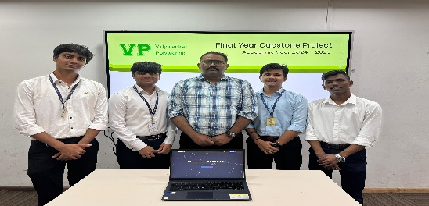
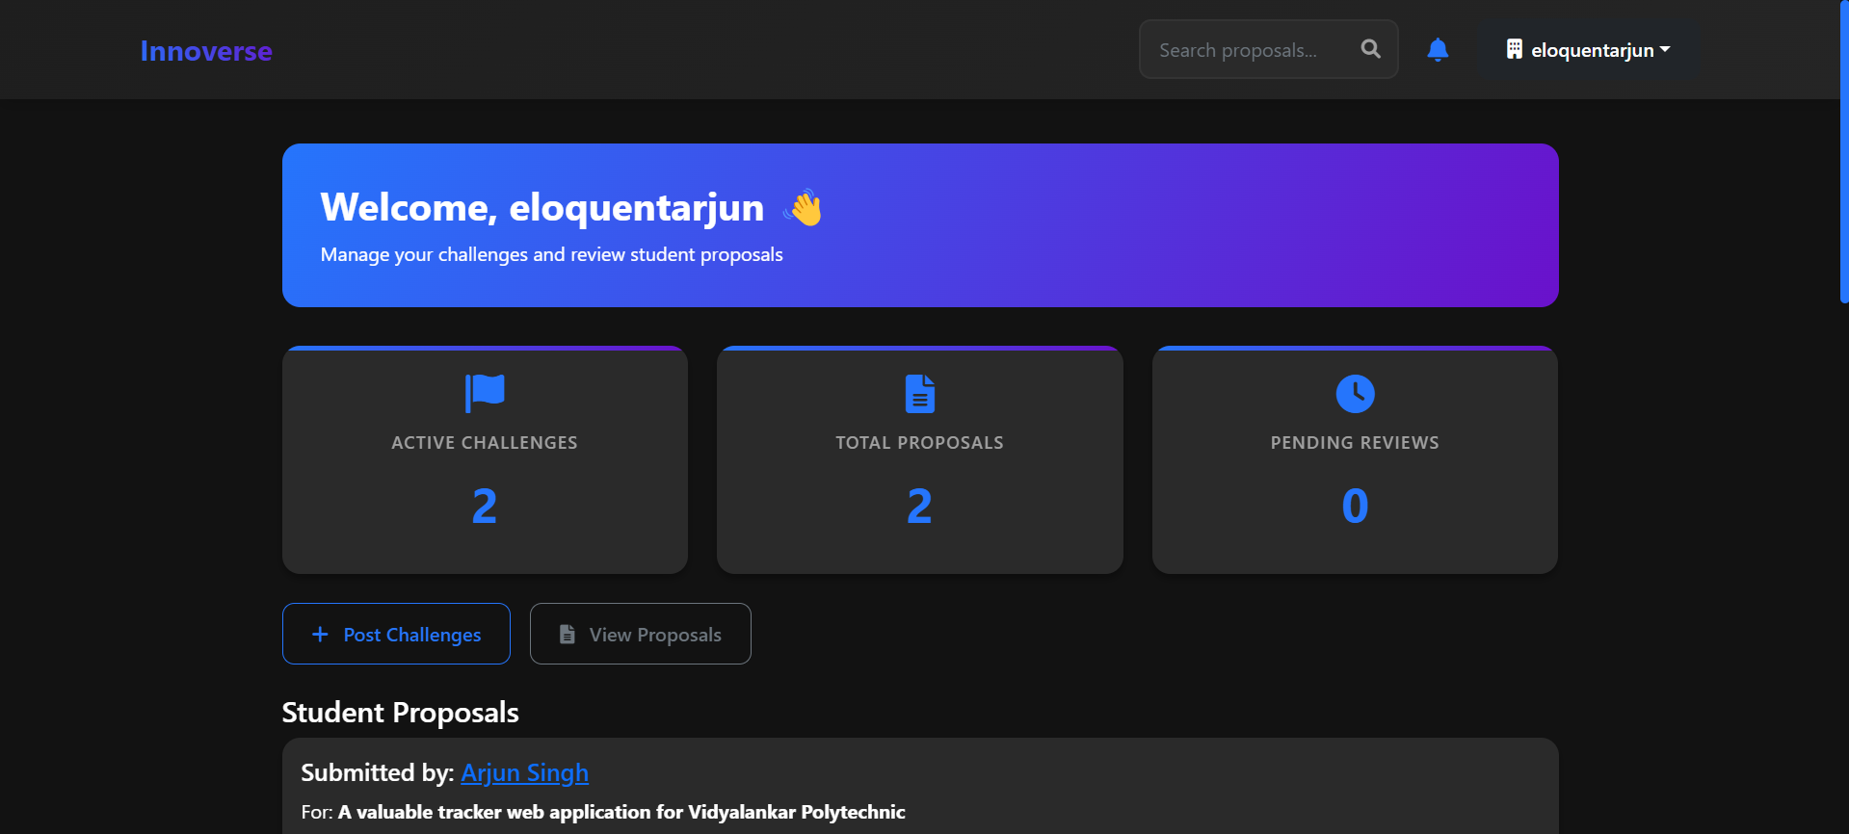
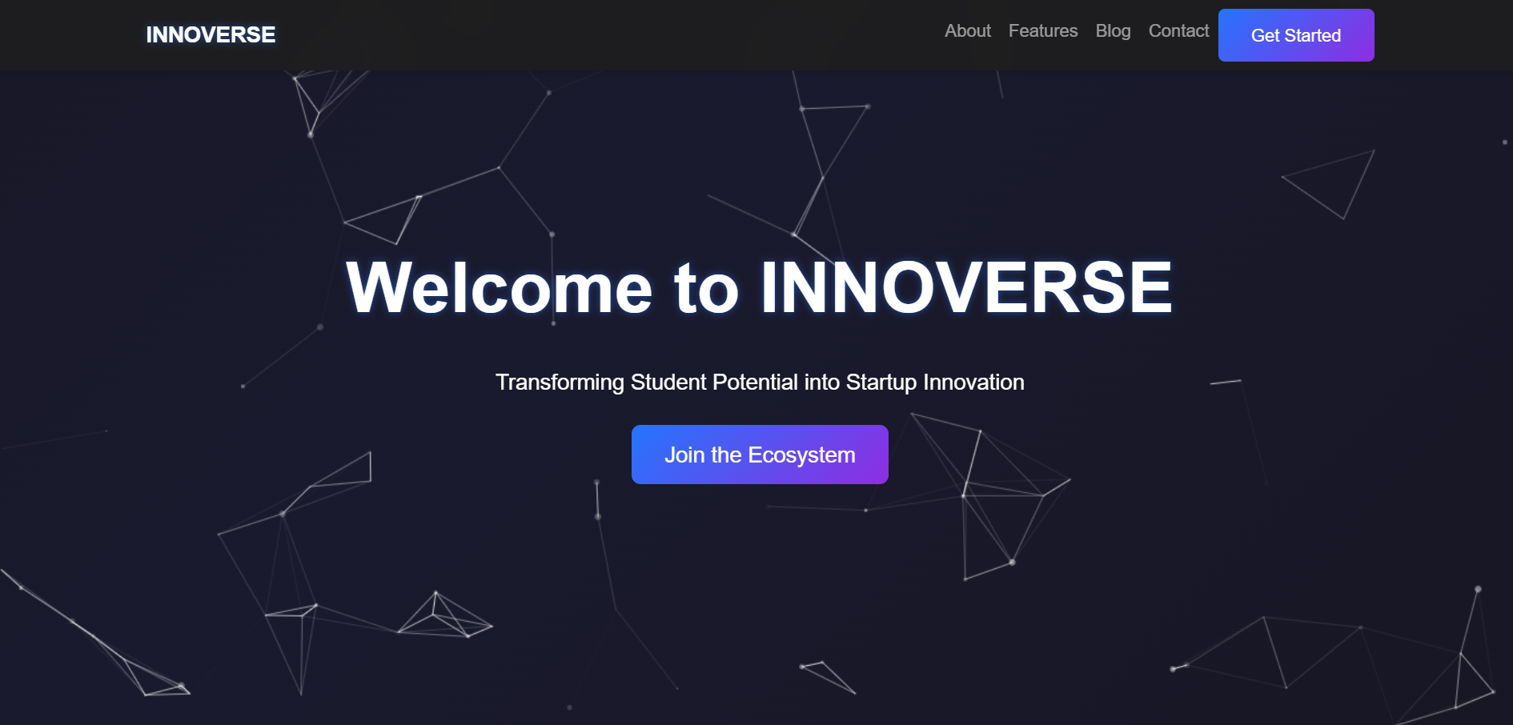
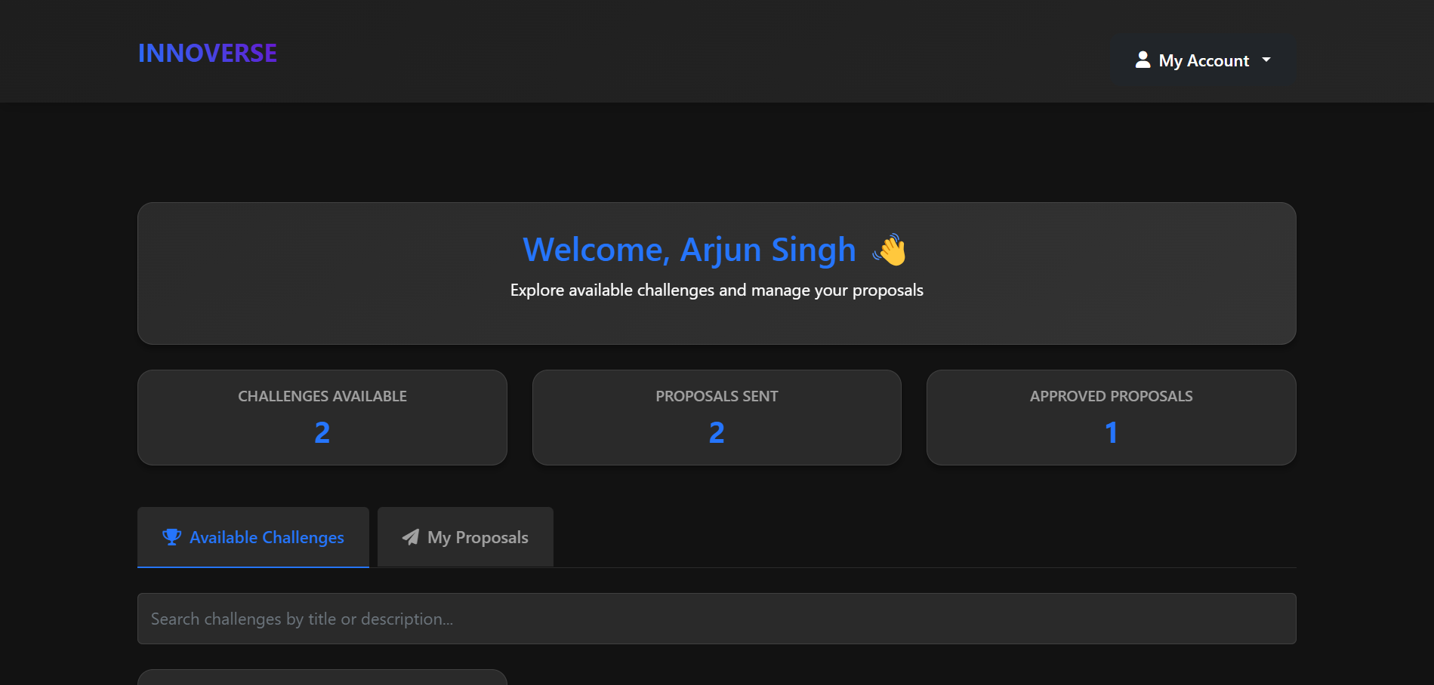
Program : Information Technology
Project Title
Domain
: Custom Collaboration Platform for Students and Startups - InnoVerse : Web Application
Name of Project Guide: Name of Students:
Mr. Sunil Dodake
22202A0039 – Arjun Singh
22202A0053 – Parth Borle
22202A0045 – Moulik Johari
22202A0037 – Manav Gaikwad
Brief idea of project:
The InnoVerse platform introduces a revolutionary approach to bridging academia and industry by offering a collaborative online environment for students and startups. Traditional educational setups often lack exposure to real-world industry challenges, leaving students underprepared for professional work. InnoVerse addresses this by connecting students with startups to work on practical projects, thus preparing them with relevant, marketable skills. This model not only enriches the learning experience but also offers startups a fresh perspective and valuable potential hires, ultimately creating a synergistic link between education and industry.
Screenshots of the Project:
Applications:
Universities and colleges can integrate InnoVerse into final-year project programs, allowing students to gain hands-on experience and contribute to real-world projects.
Startups gain access to innovative, cost-effective solutions without needing a full-time team, making it an attractive option for resource-constrained companies.
The platform can serve as an ideal base for managing hackathon projects, providing a structure for collaborative work and project tracking
1

